Slide 1
Applied Behavior Analysis
Stacey Chambers
Early Autism Program Coordinator
The Summit Center

Slide 2
Questions of focus:
What is Applied Behavior Analysis (ABA)?
What does ABA look like?
Why use ABA?

Slide 3
What is ABA?

Slide 4
What is ABA?
Applied Behavior Analysis is an evidence-based and scientific approach to behavior and learning, primarily focused on improving socially significant behaviors in the individual’s life.

Slide 5
What does ABA look like?

Slide 6
Elements of Quality ABA Instruction
Planned Reinforcement

Slide 7
Planned Reinforcement
When a positive behavior is followed by receiving something that is valued, like a reward, that desired behavior is more likely to be repeated in the future.
Preference Assessments
Work / Play Schedule

Slide 8
Elements of Quality ABA Instruction
Planned Reinforcement
Systematic Approach to Learning

Slide 9
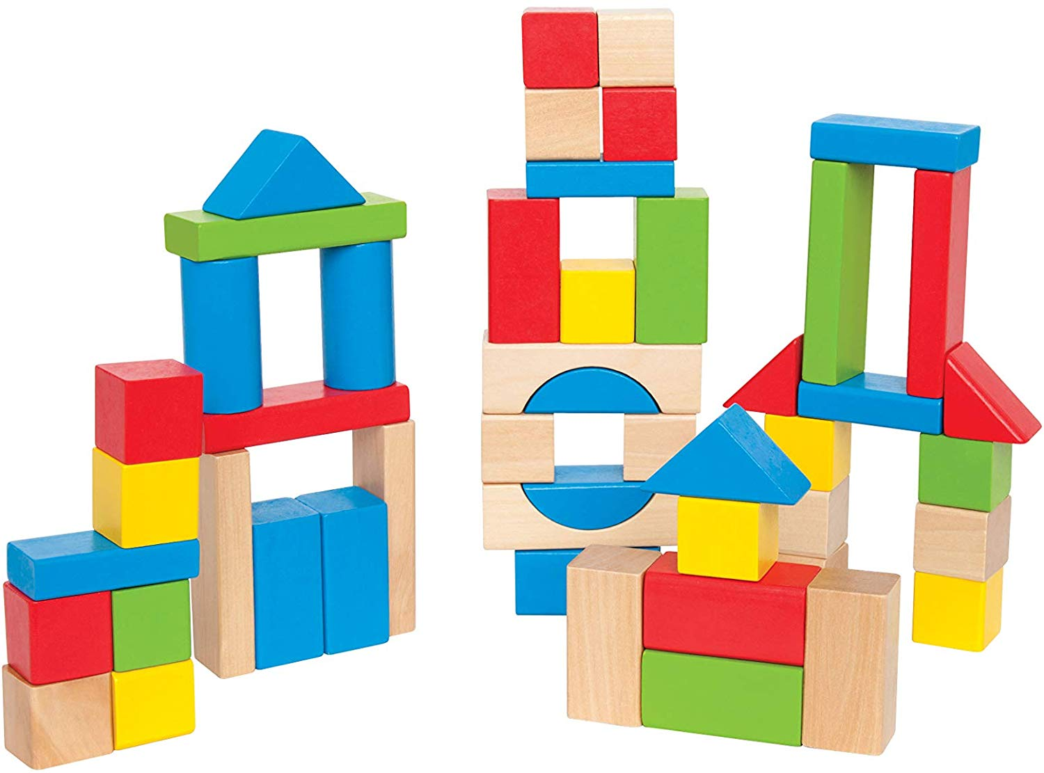
Systematic Approach to Learning

Slide 10
Elements of Quality ABA Instruction
Planned Reinforcement
Systematic Approach to Learning
Data Based Decision Making

Slide 11
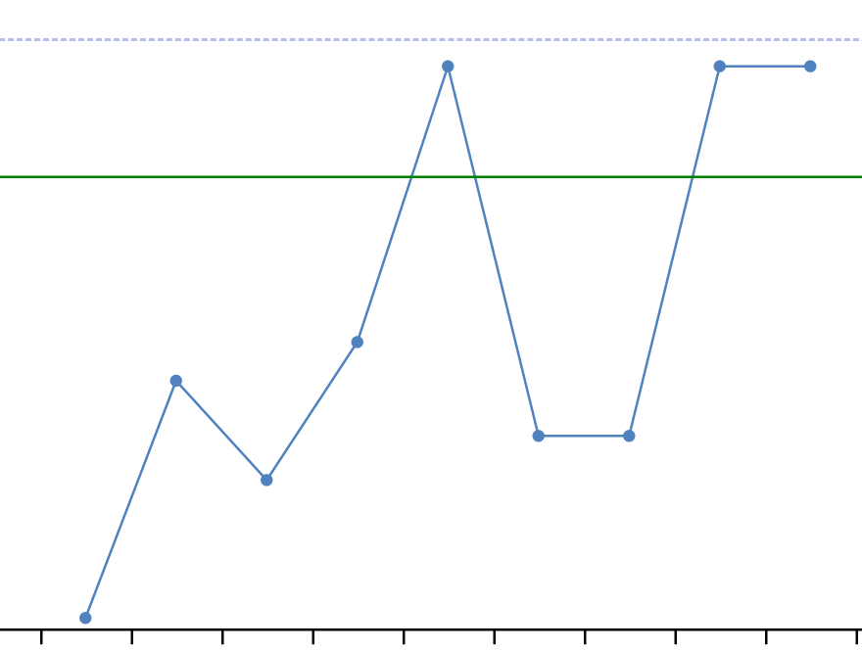
Data Based Decision Making

Slide 12
Elements of Quality ABA Instruction
Planned Reinforcement
Systematic Approach to Learning
Data Based Decision Making
Structured Environments

Slide 13

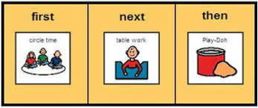
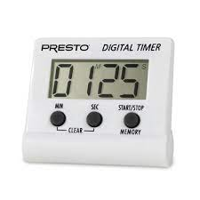
Structured Environments
Visual Supports

Slide 14
Elements of Quality ABA Instruction
Planned Reinforcement
Systematic Approach to Learning
Data Based Decision Making
Structured Environments
Functional Approach to Problem Behavior

Slide 15
Functional Approach to Problem Behavior
Medical
Escape
Attention
Tangible
Sensory

Slide 16
Elements of Quality ABA Instruction
Planned Reinforcement
Systematic Approach to Learning
Data Based Decision Making
Structured Environments
Functional Approach to Problem Behavior
Family Involvement

Slide 17
Family Involvement
Family Training / Parent Counseling-Training

Slide 18
Why use ABA?

Slide 19
National Standards Project
Established treatments are those treatments that produce beneficial outcomes and are known to be effective for individuals on the autism spectrum.
Emerging treatments are treatments that have some evidence of effectiveness, but not enough evidence to be confident that they are truly effective.
Unestablished treatments are treatments for which no sound evidence of effectiveness exists. There would be no way to rule out the possibility of these treatments being ineffective or causing harm.

Slide 20
For more information on Applied Behavior Analysis, please visit www.thesummitcenter.org.

