Slide 1
Functional Communication

Slide 2
Presenters
Rachel Epstein M.S. Ed. CCC-SLP
E-mail: repstein@thesummitcenter.org
716.629.3400 Ext. 1815 [office]
Amy Armstrong M.S. Ed. BCBA, LBA
E-mail: aarmstrong@thesummitcenter.org
716.799.8524 [office]

Slide 3
Functional Communication
Definition:
Appropriate behavior that expresses needs, wants, feelings, and preferences that others can understand.
When individuals learn functional communication skills, they are able to express themselves without resorting to challenging behavior or experiencing communication breakdown.

Slide 4
Functional Communication Training (FCT)
Differential reinforcement (DR) procedure in which an individual is taught an alternative response that results in the same class of reinforcement identified as maintaining problem behavior. And the problem behavior is placed on extinction.
Requires expertise in school psychologist/couselor/ BCBA for monitoring/adjustments with oversight from SLP and instruction from teacher.
Requires a Functional Behavior Assessment and ABC data.
Identify interfering behavior that is serving as some type of communication function.
Identify a replacement behavior as a substitute for the interfering behavior.
May begin at a step well below the student’s communication ability.
Design and implement data collection procedures.

Slide 5
FCT
Manipulation of the environment to elicit interfering behavior.
Planning opportunities for generalization.
Prompting learners to use replacement behavior.
Not reinforcing the interfering behavior.
Providing immediate reinforcement for replacement behavior initially.
Plan needs to include shaping and fading prompts.
May require skill building in related areas (waiting, excepting when not available)
Increasing time between replacement behavior (communication) and reinforcement
Monitor learner progress.

Slide 6
Functional Communication Teaching
Start out as planned and systematic.
Current ability determines reaction to communicative attempt.
Start with highly motivating items/activities to request.
Everyday contexts with familiar adults and peers.
Should extend throughout the entire day.

Slide 7
Students with Autism
Primary speech-language impairments:
Ability to understand or process language (receptive language)
Ability to communicate or express oneself (expressive language & speech production)
Social interaction (pragmatic language)
Notes:
Expand on “expressive” AAC, verbal, sign, PECS

Slide 8
Develop Language Intervention Approach
Determine what skills the student has
Choose Functional targets
Decide mode of communication that should be used for each skill

Slide 9
Selecting Functional Targets
Emphasis on function and biggest barrier:
Varies in its expression and may include personalized movements, gestures, verbalizations, signs, pictures, words, and output from augmentative and alternative communication (AAC) devices
Form of behavior that express needs, wants, feelings, and preferences that others can understand
Communication that makes one’s basic wants and needs known
Does not need to be a complex thought
Does not need to be verbal
Skills that will promote independence
Skills that will be useful (functional) for the individual

Slide 10
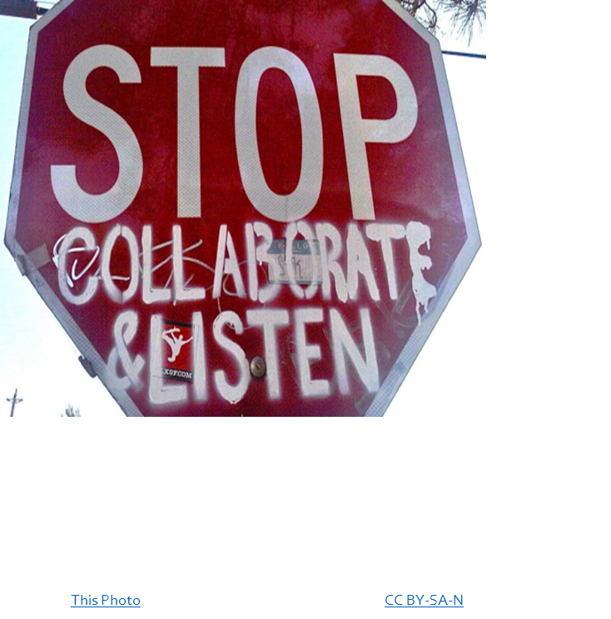
Collaboration is Key!
Collaborate with all staff to maximize instruction and positive student outcome
Staff trainings
Instruct on how to work on functional communication and expectations
Receive updates on behavior management, discuss speech and language skills, carry-over, generalization
SLPs provide guidance on mode of communication to be used when writing behavior intervention plans
Collaborate on what specific phrases or words the student will learn to functionally communicate his/her wants, needs, frustration, etc.
Provide direction and feedback to classroom team to ensure language–based instruction occurs throughout the day

Slide 11
Collaboration is Key!
Periodic communication with caregivers very important
Communicate progress towards goals
Frequency of communication typically depends on caregiver preferences
Train caregivers on their child’s communication
Discuss success on targets at home
Discuss mode of communication and how individual communicates at home
Ways to facilitate communication at home
Home/virtual visits to assess the function of communication at home and create a plan with caregivers
Collaborate on goals/targets to ensure skills are of significance/relevance to the family

Slide 12
Modes of Communication
Gestural
Sign
PECS
SGD
Verbal
Multimodal communication approach
For example, if a student uses sign language and a speech generating device, we may initially teach the sign for bathroom so he/she can readily request in any situation
If a student uses verbal speech, that may be his or her primary means of communication however, it may be used in conjunction with to another mode of communication for support or quicker results

Slide 13
Modes of Communication – Sign
Using sign language to communicate with others
Often modified for individual learners, which can make it difficult for unfamiliar listeners to understand
Barriers of using sign
Functionality of sign
Intelligibility across environments
Peer and community interactions

Slide 14
Modes of Communication – PECS
PECS – Picture Exchange Communication System
Teaches learners to give a picture of a desired item to a communicative partner, who immediately honors the exchange by delivering the desired item
Later phases of PECS goes on to teach discrimination and developing sentences to answer questions or comment
A key feature is that you are immediately building in initiation by learners to have their wants and needs met
Pairing exchange with verbal model of what the pictures represent throughout all phases, eventually building in a pause to try and evoke vocals from learner

Slide 15
Modes of Communication – SGD’s
SGD’s – speech generating devices (commonly known as ‘devices’)
They are electronic alternative/augmentative communication devices (AAC devices) that use pictures for selection and a voice output to represent the selection made by the learner
High Tech – iPad (with app installed for this purpose, communication vs. leisure), DynaVox, Nova Chat
Low Tech – GoTalk, BIGmack

Slide 16
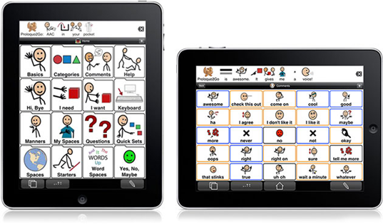
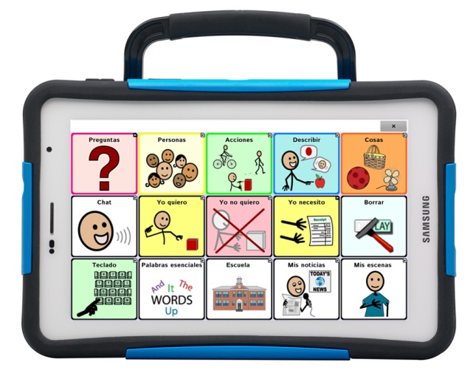
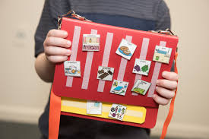
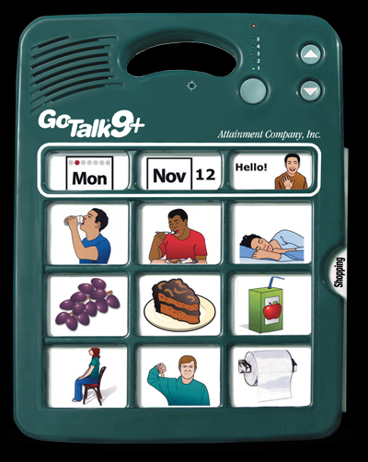
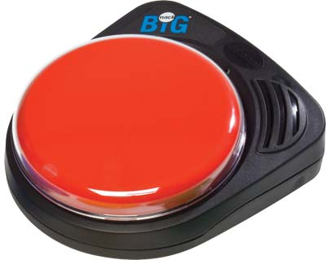
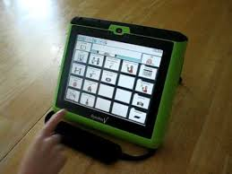
Modes of Communication
PECS (Picture Exchange Communication System)
iPad with Proloquo2Go
Nova Chat

Slide 17
Modes of Communication – Verbal
Using vocal language to communicate with others
Ideally, all learners would develop vocal communication
We should always be working on increasing our learner’s vocal communication, even if they are using another mode of communication as well

Slide 18
Things to remember with communication
Alternative form of communication should be with the student at all times.
Do not have to “work” on the step the student is currently on to have them use it or receive what they requested.
Functional usage should be ongoing in all aspects of the student’s day.
If the student is currently communicating in various ways/abilities, it is OKAY for any form of communication to be used functionally!
Notes:
Example, two icons vs 1 icon for wanted/needed items

