Slide 1
Striving for Independence: Teaching Self-Help Skills to People with Autism
Jennifer A. Toomey
The Summit Center
Getzville, NY

Slide 2
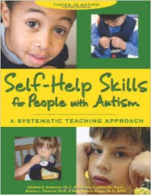
Special Thanks to….

Slide 3
Agenda
Why teach self-help skills
Choosing the right skills
Motivating your child to learn
Using effective tools for change

Slide 4
Emphasizing the Development of Self-Help Skills
Focus too little on self-help development – particularly with young children
Easier to simply do it for the child
An area where parents may feel successful – fostering dependency
Adaptive deficits > Cognitive deficits

Slide 5
Why is it important
Adaptive skills signal the beginning of independence from parents
Failure to address may prevent community integration, school functions, recreational activities, and eventually housing and job opportunities
Challenging behavior and the absence of S-H skills most often associated with out-of-home placement

Slide 6
Weaknesses for children with ASD
Problem with generalization
Problem learning complex skills requiring abstraction or attention to social norms
Ability to understand language
Restricted/stereotyped range of interests-attention
Sensory sensitivities
Other behavioral concerns

Slide 7
Parents’ Role
Teaching self-help skills is complex
Significant investment of time
May be able to scaffold on top of things already doing
Are there limits on what parents can be expected to accomplish?

Slide 8
School’s Role
Individuals with Disabilities Education Improvement Act – Revised, 2006
Indicates a responsibility to address all areas of development, including self-help

Slide 9
School’s Role
General education – focus on meeting academic standards
Most kids come prepared already
Environment not very conducive to instruction (e.g., toileting skills)
Focus on transfer of skills
Measuring success at school (check lists)
Special education – greater responsibility

Slide 10
Choosing the right skills

Slide 11
Is the child ready?
Age-Appropriate (don’t get too far ahead)?
Functional Skills (important for child now)?
Prerequisite behaviors (able to attend and follow simple instructions; imitation)?
Shown any interest?
Any physical limitations (accommodations)?

Slide 12
Learning-to-Learn Skills
Consistently looks when you call his name?
Pays attention when given a direction?
Follows simple one-step directions such as come here, sit down, wait, stand up, give me…?
Consistently makes and sustains eye-contact for at least three seconds?
When asked to, looks at objects or materials?
Sits or remains in a defined area for at least 10 minutes (with or without close supervision)?

Slide 13
Learning-to-Learn Skills (continued)
Communicates simple wants and needs?
Points to common body parts?
Responds to physical guidance without resistance?
Imitates simple motor actions?

Slide 14
Skills Inventory
Functional Area
Tasks
Skill Targets
Prioritize
Develop goals
Notes:
Give page from the skills inventory

Slide 15
Motivating The child to Learn

Slide 16
Need for Rewards
Items that many of us find reinforcing (e.g., recognition, task completion, etc.) may not be sufficient to motivate children with autism

Slide 17
Potential Reinforcers
Praise – most practical
Food – very powerful
Attention (verbal and physical)
Activities
Praise + Super rewards

Slide 18
Examples of Activity Reinforcers
Spending time with preferred people
Special activities
  Recess, computer time
Special responsibilities
  Line leader, picking story

Slide 19
Fading Reinforcers
Frequent use of rewards is a tool for teaching, not the end result
Gradually begin to expect more from the child before reinforcement is delivered
Fading too quickly may lead to failure, while waiting too long may lead to increased dependence
Fade to a level that is to be expected in the most natural setting

Slide 20
Using Effective Tools for CHange

Slide 21
Steps to Successful Teaching
Clearly specify the target skill
Break complex skills into smaller steps
Use a systematic approach to teaching
Monitor progress
Modify the approach, as needed, based on the progress achieved

Slide 22
Step 1: Specifying the goal
Four basic components:
  An instructional context in which the skill will occur
  Pinpoint observable and measurable behaviors
  Should be realistically attainable within a few months
  Should specify the mastery criteria (how and when you will know the student has acquired the skill)

Slide 23
Examples
With her shirt over her head [context], Anna will finish putting on her shirt [behavior].
With her shirt laid on her bed, Anna will put her shirt on.
After hearing and responding to an alarm clock, Anna will dress herself.

Slide 24
Step 2: Breaking tasks into steps
A Task Analysis breaks a task into smaller, more easily attainable steps
The number of steps depends on the student’s prerequisite abilities and skills
Increases the number of opportunities for reinforcement and success

Slide 25
Handwashing Task Analysis
Turn on warm and cold water
Places hands under water
Places one hand under and other hand under soap dispenser
Pushes soap down
Rubs soap between hands
Rubs back of right hand
Rubs back of left hand
Rinses hands under water
Turns off water
Takes towel
Dries hands

Slide 26
Step 3: Systematic approaches to teaching
Frequently practice emerging skills
Provide high levels of repetition
Commit to a teaching approach until its results can be clearly evaluated
Utilize proven tools for instruction, including:
    Chaining
    Prompting
    Shaping

Slide 27
Chaining
A method of linking relatively simple steps (task analysis) to form a more complex task (a chain of behavior)
Each step in the chain signals the next step to be completed and reinforces the previous step
Three methods of chaining:
  Backward, Whole chain, Forward

Slide 28
Chaining Method
Establish a baseline of how the child completes the task without any assistance
  If child can complete some steps and needs little physical assistance, use whole-chain
  If child cannot complete most steps but can respond to delayed reinforcement, use forward
  If child cannot complete most steps, needs physical assistance and/or needs immediate feedback, use backward

Slide 29
Using Chaining with Toothbrushing
Step | Independent
1. Pick up toothpaste | Yes
2. Remove cap and hold tube with one hand | Yes
3. Pick up toothbrush with other hand | Yes
4. Place a small amount of paste on brush | Yes
5. Turn on cold water | Yes
6. Wet toothbrush | Yes
7. Place toothbrush against teeth | No
8. Move toothbrush up and down 10 times | No
9. Spit toothpaste into sink | Yes
10. Rinse mouth with water | Yes
11. Place toothbrush into holder | Yes

Slide 30
Prompting
Essential to teach a skill not in the student’s repertoire
Must be faded quickly and systematically
  Avoid prompt dependence
Most-to-least method of fading

Slide 31
Types of prompts
Type of Prompt | Example
Physical guidance | Hand-over-hand: Place your hand over child’s hand, pick up toothbrush and bring up to the child’s mouth Partial guidance: Tap the child’s arm to assist him in picking the toothbrush up to his mouth
Visual cue | Show a picture of a child brushing his/her teeth
Modeling | Get the child’s attention and show them how to brush their teeth
Gestural | Point to the toothbrush
Verbal | Say “Pick up your toothbrush”

Slide 32
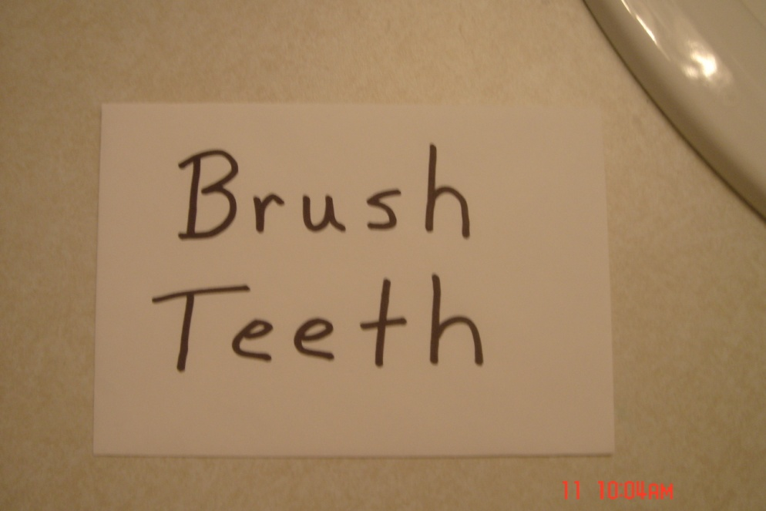
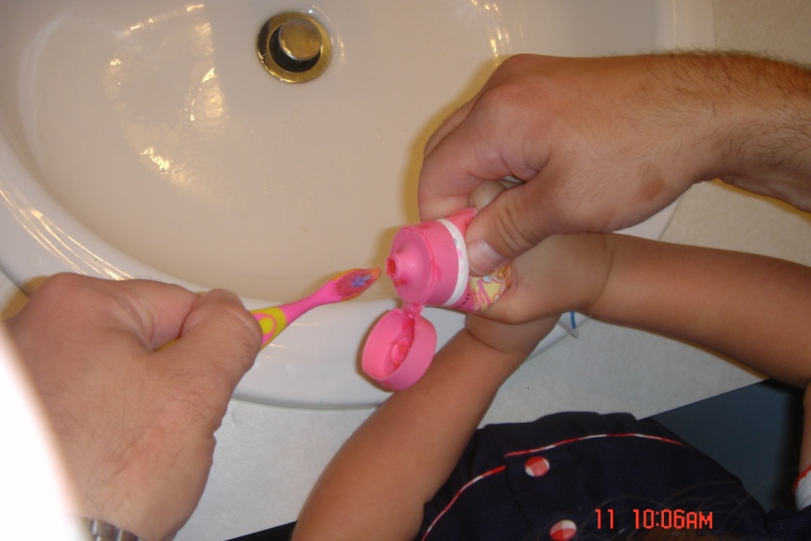
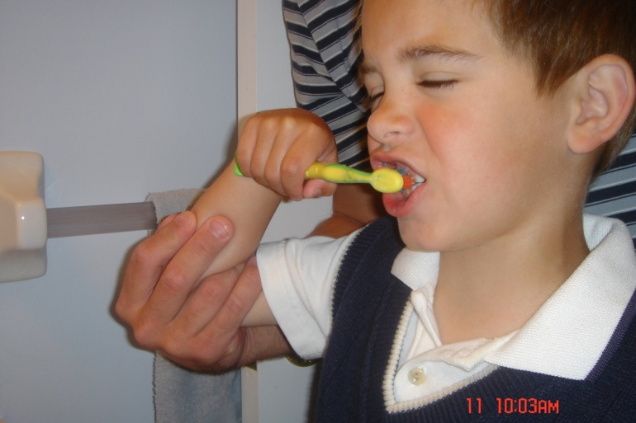
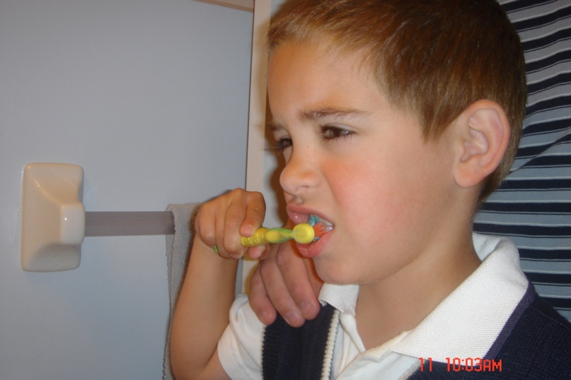

Examples of Prompts

Slide 33
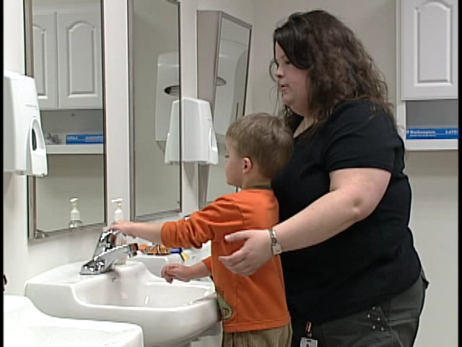
Prompting

Slide 34
Shaping
Using reinforcement with approximations of a newly developed or rarely occurring behavior

Slide 35
Step 4: Monitoring progress
Need to consistently monitor student’s progress and compare to the learning goals that have been established
Rate of progress will vary by child and will be influenced by the complexity of the skill being taught, the consistency of the teaching methods and other factors (e.g., location, number of opportunities, etc)

Slide 36
Examples of Objective Measurement
Measure | Explanation | Example
Frequency | How often the child initiates going to the bathroom | John will have no more than one toilet accident a week.
Number of successfully completed steps | Each sequenced step is scored as correct or incorrect. | Erin will shave, completing 80% of the steps with no help.
Number of prompts | The parent counts the number of times that they have to help (prompt). | James will tie his shoes with two or fewer prompts.
Duration | The parent measures how long it takes the child to complete the task. Useful when the child is slow to complete them. | Keri will eat his lunch and clear his plate and utensils within 20 minutes.
Accuracy | Record whether the child dressed in clothing that was color coordinated. | Ricky will dress himself in a shirt and pants that are color coordinated.
Combined method | Combining two or more dimensions into a single criterion. | Terri will brush her hair and teeth within 15 minutes with two or fewer prompts.

Slide 37
Step 5: Modifying teaching
Monitoring progress is not very beneficial unless the data collected is useful in making decisions to enhance teaching
Frequently, simple instructional modifications can be made if the student is not meeting their goals in the desired time frame
Will discuss options later

Slide 38
Writing an instructional plan
A detailed plan facilitates organized and systematic instruction
Allows multiple people to instruct the student in a similar manner

Slide 39
Summary
Teaching self-help skills to children with autism may be one of the most important things a parent, teacher or caregiver does
Independence from caregivers opens the door to many opportunities
Starting too late, may require undoing bad habits before new skills can be added

Slide 40
Questions??
jtoomey@thesummitcenter.org
Thank you!

