Slide 1
Strategies for Effective Advocacy for Children with Autism
Rebecca Meyer, M.s., M.S.W.

Slide 2
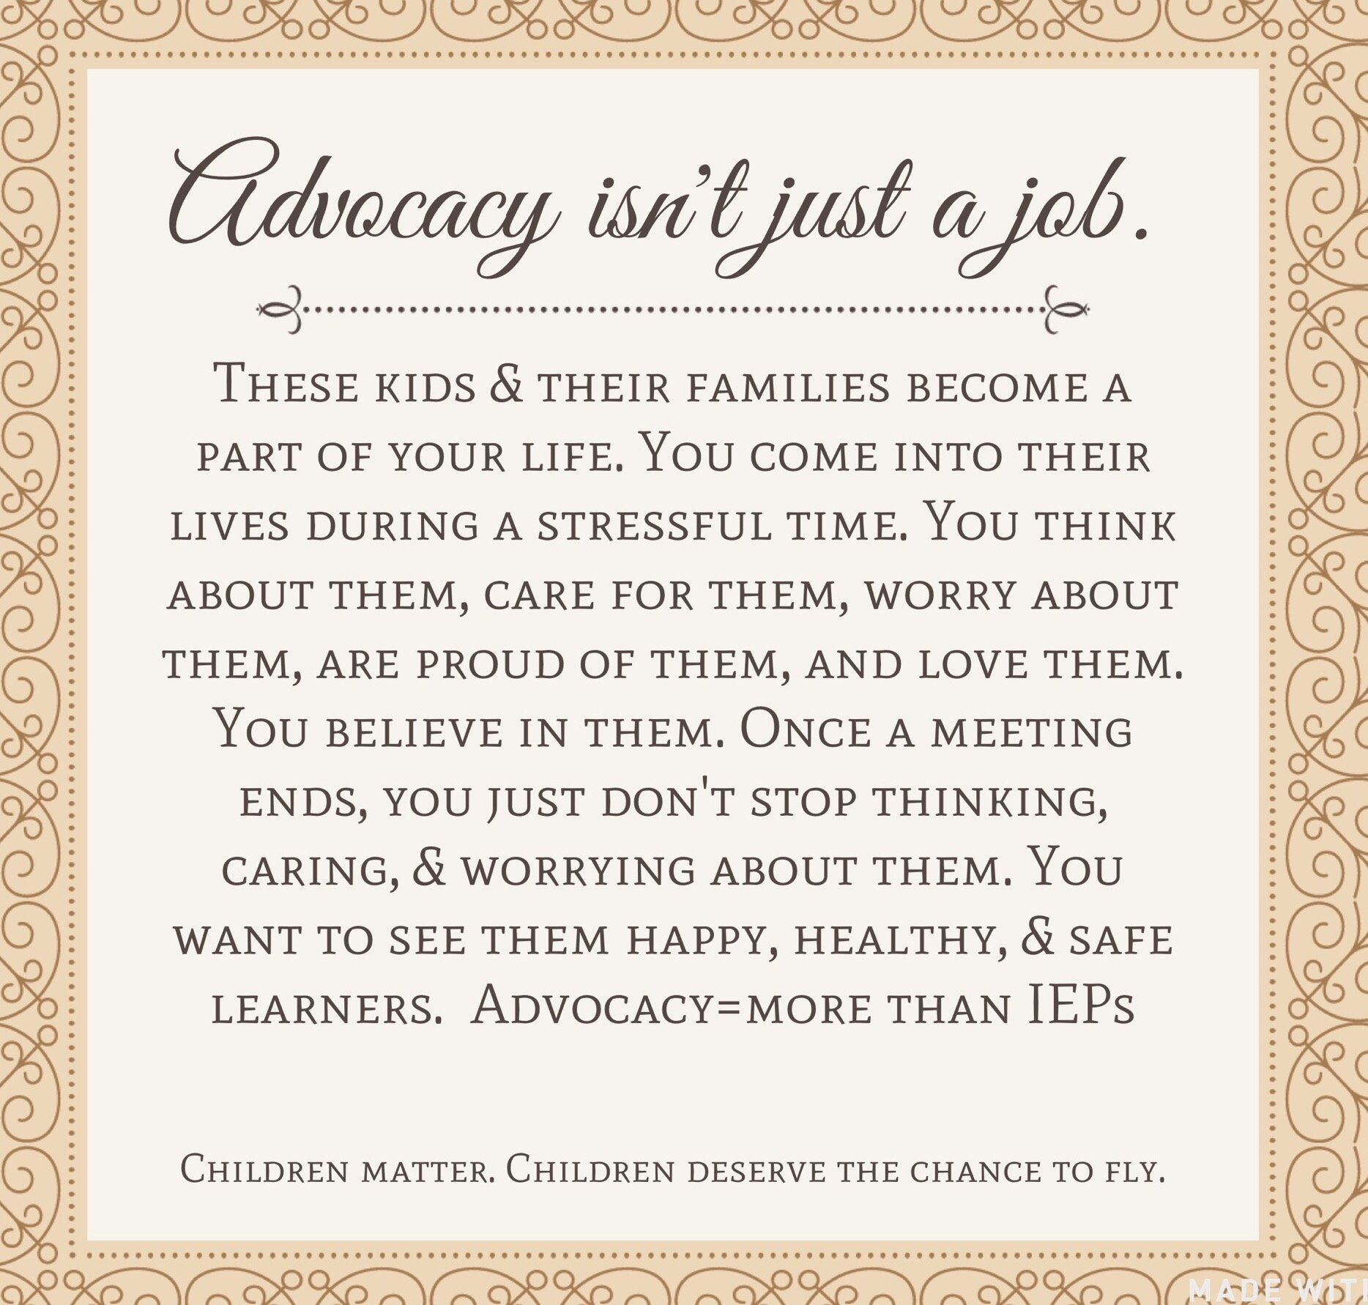
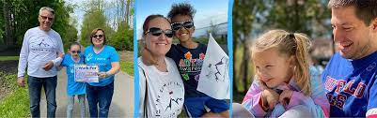
Why is this Important?

Slide 3
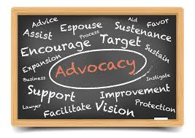
What is Advocacy?
“The act or process of supporting a cause”
Advocacy in ASD literature is any action
taken on behalf of a child with ASD to
“ensure adequate support, proper level
of care, and basic human rights.”

Slide 4

What is Collaboration?
“To work jointly with others ”
In ASD, the complex symptomology and
high rates of comorbid diagnoses, require
treatment across a range of professional
disciplines, and in a range of settings.

Slide 5

The Relationship Between
Advocacy and Collaboration
“Collaborative Advocacy is an approach to
advocating for children with disabilities that
utilizes collaborative problem-solving skills and
relationship-strengthening strategies to resolve
disagreements.”
In short, we can better meet the needs of
a person with ASD, when we work together.

Slide 6
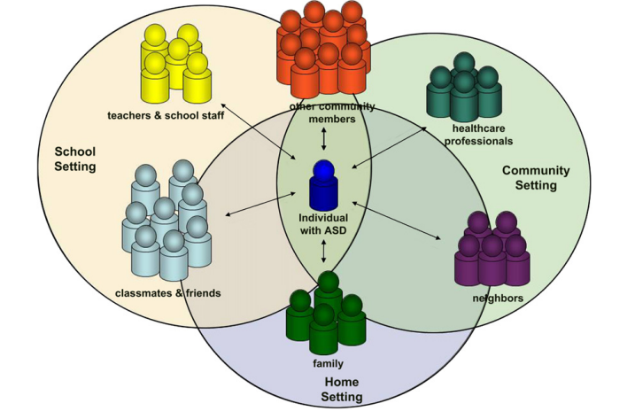
Multi-Disciplinary Team:
Who is Involved?
-Parents and Caregivers
-Group Homes/Residential
Treatment Providers/After School
Care
-Medical Providers
-Clinical Psychologists
-Social Workers
-Care Coordinators
-Behavior Support
-Special Education Teachers
-TAs, CAs
-SLPs, PT, OT
Anyone can be an advocate
and involved in collaboration
Figure from Swiezy et al. (2008)

Slide 7

Benefits to Advocacy and Collaboration
Professionals must blend a variety of
strategies based on an individual’s
strengths, learning style, and needs
Research shows:
-enhanced problem solving
-increased efficiency
-access to additional resources
-consistency in programming/intervention
-better maintenance of acquired skills

Slide 8

Barriers to Successful
Advocacy and Collaboration
“It is unrealistic to think that simply
bringing professionals together in
teams will lead to collaboration.”
With so many disciplines involved,
differences arise…
“Too many cooks in the kitchen…”
D’Amour et al. (2005)

Slide 9

Parent and Caregiver Perspectives
“He was the type of doctor who was patronizing you
like he thought that everybody was like at this intellectual
level and then he was here – it was terrible, and he would
not be open minded and he was just stuck in his run and
there was no way to discuss it in a very free way.”
“I’m a very strong advocate and I’ve kicked doors, but I had
to work really hard…I’ve been yelling and screaming on
the top of my lungs sometimes to get him where he is…
that’s basically how we’ve navigated through the system.
…(our son) has fell through the cracks many, many, many
-too many times.”
“I’m my child’s expert…I’ll take their advice if I
think it’s what’s best and it fits for him.”

Slide 10

Barriers to Advocacy for
Caregivers
-Economic Status
-Education and Skills
-Language barriers
-Time commitment
-Meeting are often scheduled last minute
“Because of all the different and contradictory
advice they are getting, parents end up going
from professional to professional, centre to
centre, and from doctor to doctor, torn
constantly between hope and despair.”
de Clercq and Peeters (2006)

Slide 11

Clinician Perspectives
In a survey of over 300 behavioral
professionals, 67% had not taken any
courses or training on collaboration
Other Factors:
-Time
-Knowledge
-Service Availability
-Organization Culture
-High staff turnover
-Large caseloads
Many professionals are taught to function
independently with our own terminology

Slide 12
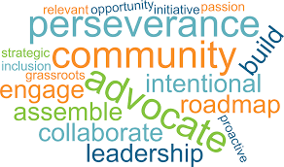
Barriers to Advocacy for
Clinicians
Challenges with Clinician and Caregiver
Communication:
-awareness of how to help families navigate treatment options
-perceived resistance from families
-differences in caregiver and clinician perspectives
-parent motivation
-cultural differences
-language differences

Slide 13

Breaking Down Barriers for Clinicians
-Collaborative Communication:
-Open communication and sharing information
-Ongoing communication
-Mutually understood language
-Distinguished Roles:
-Role delineation
-Respect unique knowledge
-Client centered care
-Conflict resolution (address issues as they arise)
-Professional flexibility
-Collective ownership
Bowman et al. (2021)

Slide 14

Breaking Down Barriers (Continued)
-Communication with caregivers should be ongoing
and frequent
-Re-state caregivers’ questions and concerns
-There is a tendency for clinicians to explain own
interests and concerns, which do not always match
caregiver priorities, so ensure everyone is heard
-Balance objective information with empathy
-Normalize not knowing and asking for help
-Having a point person, like a social worker or care
Coordinator can help
“Parents have a difficult life, but professionals have a difficult job.”
de Clercq and Peeters (2006)

Slide 15

General Tips for All
-Importance of a solution focused approach
-Find common goals
-Do your research and ask questions
-Less is more (be focused and concise)
-Sometimes it’s not personal
-Don’t let biases or assumptions get in the way
-Watch tone and body language
-Know when to walk away and try again
-Know where to go for follow up

Slide 16

Questions?

Slide 17


The Summit Center
Special Thank you to:
-Gretchen Abdulla
-Dineen Harvey
-Ross Naber
-Johanna Shaflucas

Slide 18
References:
Bowman, K.S., Suarez, V.D., & Weiss, M.J. (2021). Standards for Interprofessional Collaboration in the Treatment of Individuals with Autism. Behavioral Analysis in Practice, 14: 1191-1208.
D’Amour, D., Ferrada-Videla, M., San Martin Rodriguez, L. & Beaulieu, M.D. (2005). The Conceptual Basis for Interprofessional Collaboration: Core Concepts and Theoretical Frameworks. Journal of Interprofessional Care, 19: 116-131.
de Clercq, H., & Peeters, T. (2007). A partnership between parents and professionals. In J. M. Pérez, M. González, M. L. Comí & C. Nieto (Eds.), New developments in autism: The future is today (pp. 310–340). London: Jessica Kingsley Publishers.
Morris, R., Greenblatt, A., & Saini, M. (2019), Healthcare Providers’ Experiences with Autism: A Scoping Review. Journal of Autism and Developmental Disorders, 49: 2374-2388.
Smith-Young, J., Chafe, R., Audas, R. & Gustafson, D.L. (2022). “I Know How to Advocate”: Parents’ Experiences in Advocating for Children and Youth Diagnosed with Autism Spectrum Disorder. Health Services Insights, 15: 1-11.
Swiezy, N., Stuart, M. & Korzekwa, P. (2008). Bridging for Success in Autism: Training and Collaboration Across Medical, Educational, and Community Systems. Child and Adolescent Psychiatric Clinics of North America, 17: 907-922.

