Slide 1


Help ME Help YOU!
Teaching Children with Different Abilities to Complete Chores at Home

Slide 2
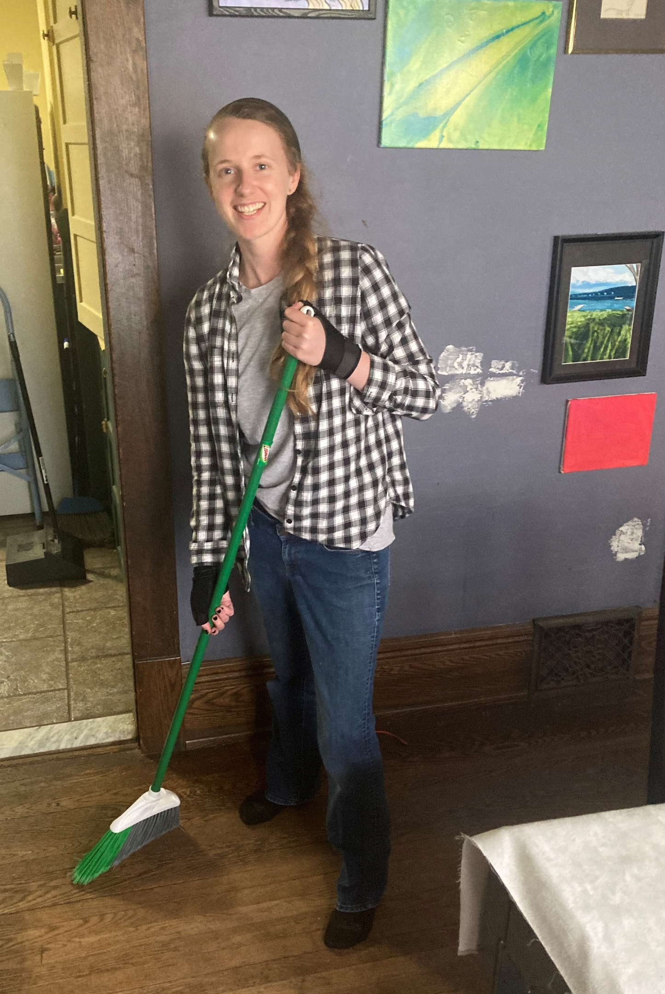
HELLO, CAREGIVERS!
I am Special Education Teacher & Board Certified Behavior Analyst
Experience with:
  Preschoolers
  School-age
  Adults
Passion for teaching independent living skills!

Slide 3
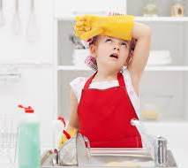
What Are the Challenges to Teaching Chores?
Teaching takes time & consistency
Teaching can be tiring
  For you and your child!
Learning takes motivation and tolerance
  Especially difficult for children with behavioral challenges
  Learned helplessness may present a barrier

Slide 4
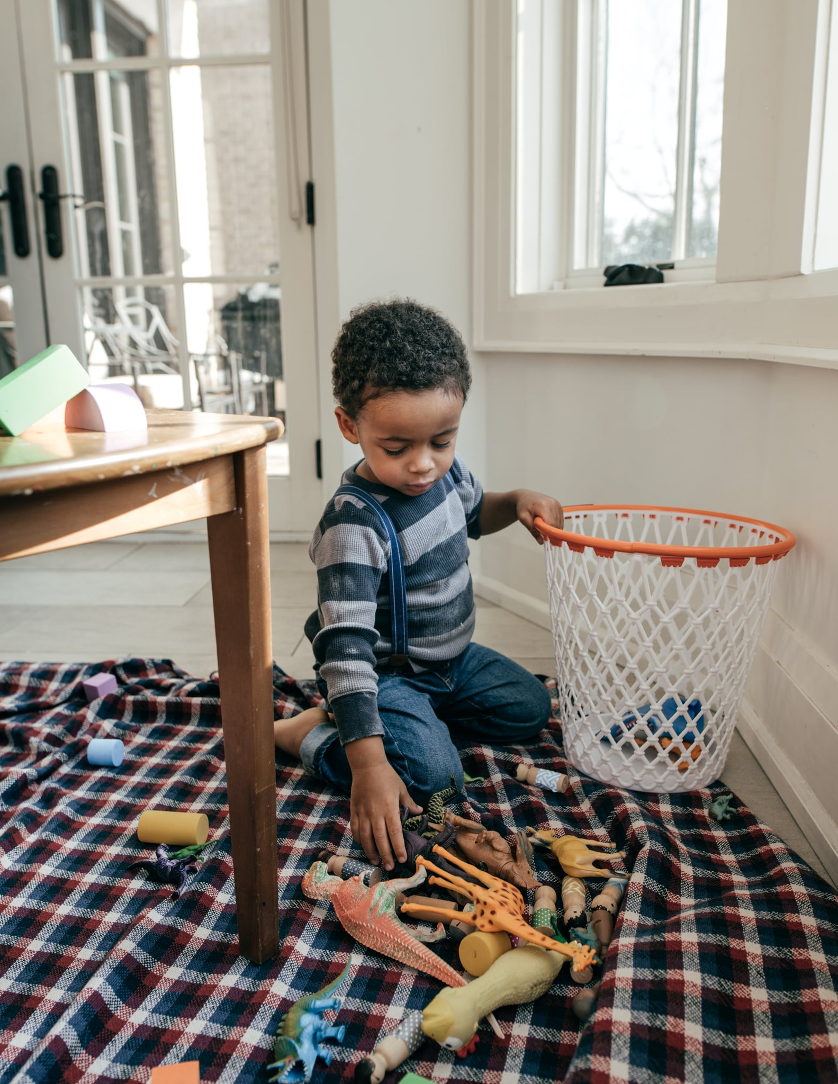
Your Child is Capable!
Both tolerance & skill level can be improved!
Teaching Methods:
  Contrived Learning
  Errorless Teaching
  Prompts & Prompt Fading
  Video Models
  Visual Supports

Slide 5
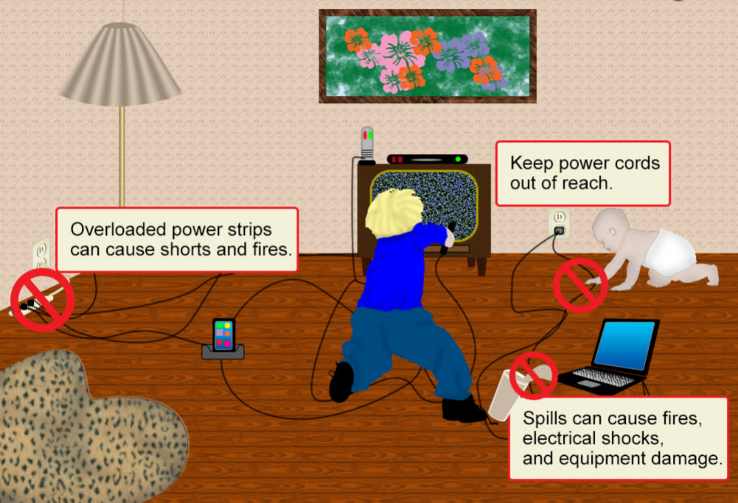
Short-Term Benefits of Helping Out at Home
Exposure to household safety concepts!
  Electronics/Fire Safety
Increased self-reliance
  Community
  Generalization may occur in vocational settings (Harr, 2011)
Opportunities for problem-solving
You get a break!

Slide 6
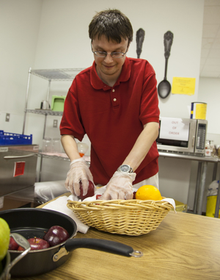
Long-Term Benefits of Helping Out at Home
Vocational
  Opportunity to practice skills they may use in a job setting
    Cleaning, food prep, sorting food/items, etc.
Day habilitation program placements
  “Without walls” programs – volunteer work
  Independence is a determinant of placement
Residential placements
  More skills = less restrictive
Independent or Supported Living Opportunities!

Slide 7
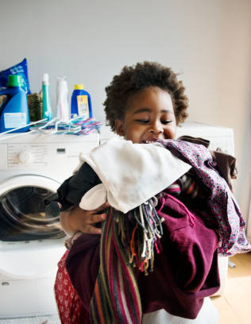
Assessment is Important
Assessment should always come before choosing and working on a chore
Helps determine:
  Preferred vs. non-preferred chores
  Level of thoroughness and independence
  Chores they are likely to succeed with
  Ideal teaching methods
  Order in which skills should be taught
What, How, and When!?
  Let’s make it simple…

Slide 8
Chore Checklist: What is it?
Simple chart to take note of your child’s current level of thoroughness and independence with a litany of household chores
Divided into basic, intermediate, and advanced skills
Rating each skill based on:
  Thoroughness (score 1-3)
    1: no ability
    2: skipped steps, some mess remains
    3: thorough
  Independence (Y/N)
    Do they recognize when the chore should be performed, and complete it without need of a prompt from me?

Slide 9
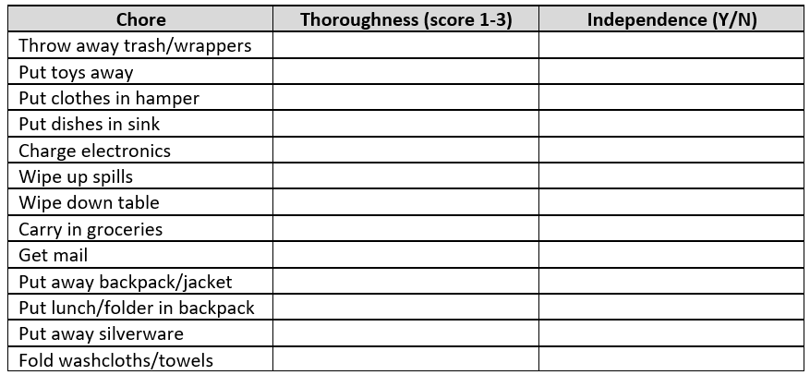
Chore Checklist: Basic Level Skills

Slide 10
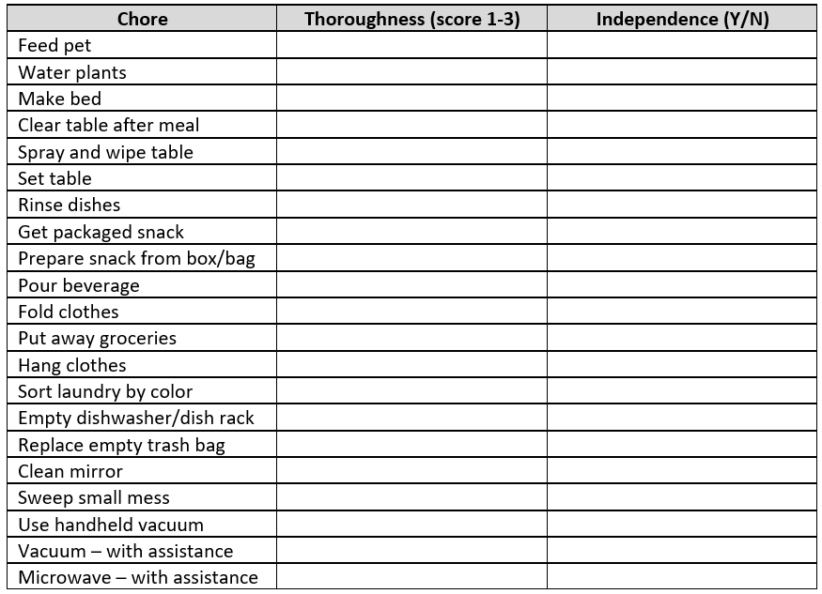
Chore Checklist: Intermediate Level Skills

Slide 11
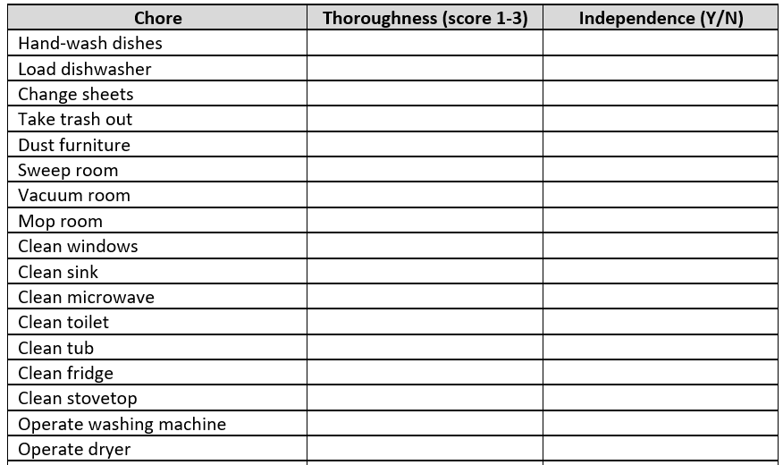
Chore Checklist: Advanced Level Skills

Slide 12
Chore Checklist: How & When
Take a “baseline” measure of their abilities
  Best practice, but not necessary!
  Give your child a simple verbal direction (e.g.. “hang up your backpack”)
  If they do not retrieve materials independently, guide them to where they are located, and wait to see what they do!
Fill out based on past observations
  If a chore is not currently safe or feasible
Watch out for splinter skills!
  Ex: can put away silverware from dishwasher, but not plates
  Ex: can spray and wipe a table but don’t retrieve cleaner or paper towels themselves
Keep using it!
  Re-assess quarterly or annually

Slide 13
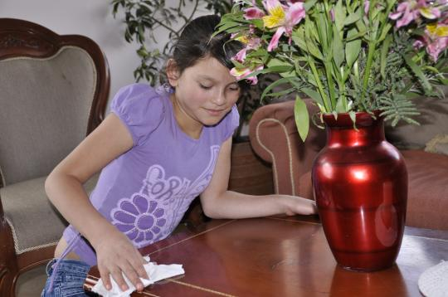
Choosing Chores
  Look at your checklist & choose 1-2
    Work on these until they are thorough & show improved independence
  Prioritize chores of focus based on:
    Natural interest
    Degree of tolerance
    Relevance (frequency)
    Easily built into their routine
    Show some success!
  Talk with teachers ☺

Slide 14

Teaching Thoroughness & Independence
  Thoroughness
    Ask yourself: “is this how I want my child to perform this task at their job?”
    Includes ALL steps, including getting and putting away items!
  Independence
    BEST OUTCOME: Child does chore thoroughly without need of initial cue or visual supports
    GREAT OUTCOME: Child does chore thoroughly without need of initial cue, with visual supports
    GOOD OUTCOME: Child does chore thoroughly with initial cue and/or visual supports

Slide 15
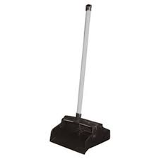
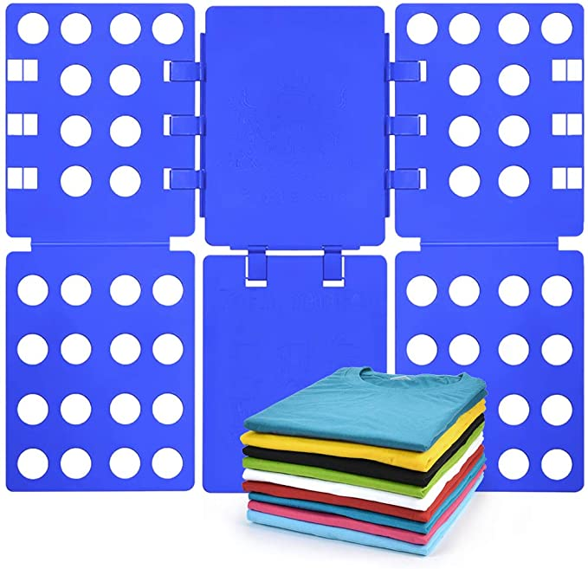
Troubleshooting Tolerance
  Where does the problem lie?
    Gross/fine motor issues
      Ex: use butler instead of dustpan
      Ex: shirt folding board
    Sensory issues
      Ex: gloves to wash dishes
    Skill deficit
      Teaching Strategies
    Aversion to correction
      Teaching Strategies
    Difficulty transitioning
      Reinforcement & routine

Slide 16
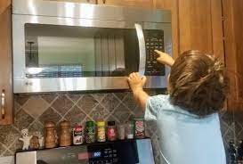
Building Chores into Routines
  Think about…
    Cue
    Reinforcer
  Best outcomes for independence have natural or built-in cues!
    Ex: Get up → Make bed
      Getting out of bed is the cue for pulling up the sheets
  Children on the spectrum thrive with routine
  Naturalistic reinforcement
    Easy for food preparation!
    Ex: If child asks for chicken nuggets, teach them how to get their plate, portion, and operate the microwave safely with assistance

Slide 17

Building Chores into Routines
  Contrived Reinforcement
    Providing additional reinforcement to change behavior
    Great for introducing less preferred chores!
  First-Then
    Ex: "You can definitely watch some SpongeBob, but let's fold these first“
    Ex: "Help me pick up the playroom and then we can go for a walk!“
    Visuals can support this!

Slide 18
Building Chores into Routines
  SCENARIO: Your child loves the iPad and sometimes has a hard time relinquishing it. He refuses to fold towels, and heavily protests whenever he is presented with them (preferring to remain on the iPad).
  SOLUTION: Before giving back the iPad following a bath or shower, after he’s dressed, direct him to fold his towel. Over time, as he gets more comfortable and less averse to the skill, ask him to help you fold his and your towel…

Slide 19
Building Chores into Routines
  SCENARIO: Your child loves eating gummies as a snack when she gets home from school. She often waits for you to take off her coat and hang it up, and never hangs up her backpack.
  SOLUTION: Direct your child to take off their coat and backpack and hang them up “so you can go enjoy some gummies!”. Keep the bag of gummies in sight, unopened. Alternatively, give 1 gummies after each step, then the remainder of the bag when they’ve finished.

Slide 20
Building Chores into Routines
  SCENARIO: Your child loves going for family walks around the neighborhood after dinner. You are trying to work with them on clearing the table after meals.
  SOLUTION: Direct them to clear the table if they want to go for a walk in the neighborhood!

Slide 21
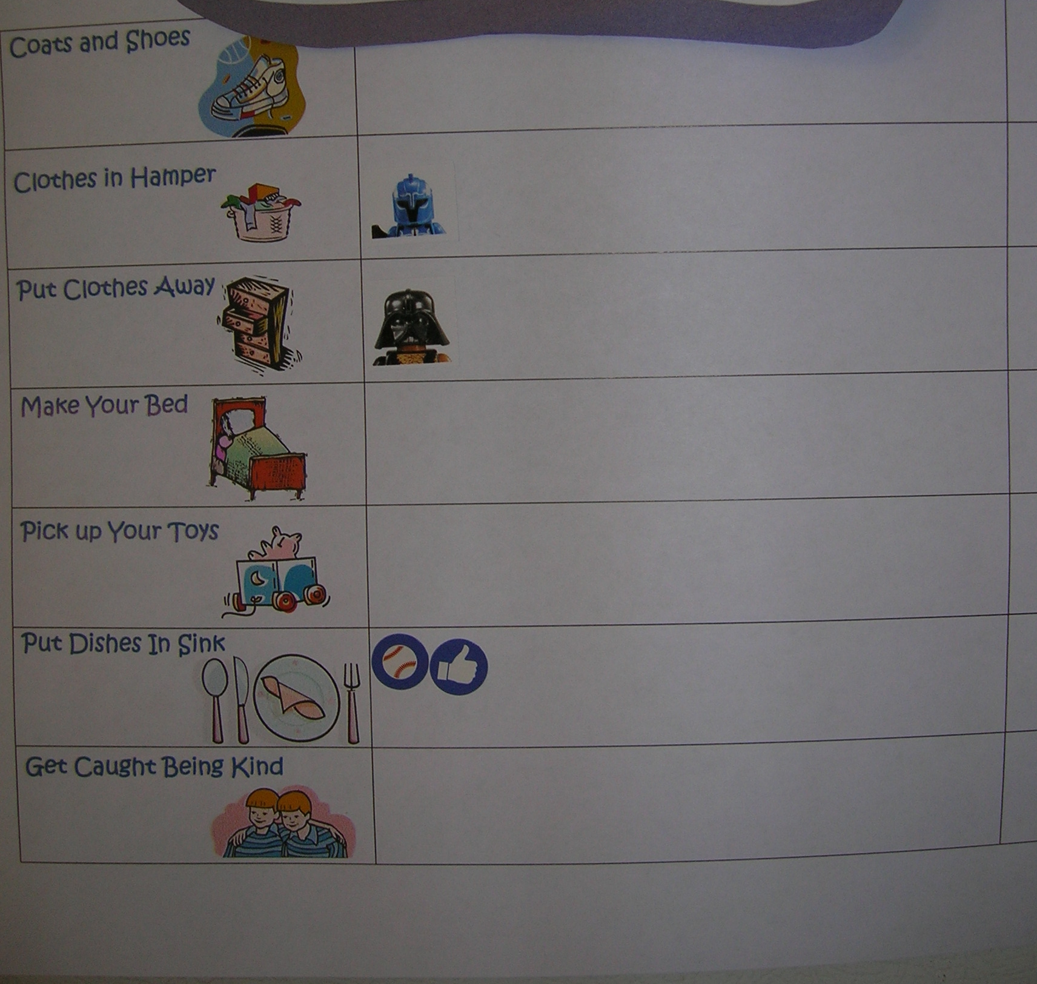
More Reinforcement!
    Praise, praise, praise!
      “You’re so helpful”
      “You are trying so hard!”
      “Thank you for ______”
    Delayed Reinforcement
      Sticker charts
      Chore bucks & charts
      Allowance ☺

Slide 22
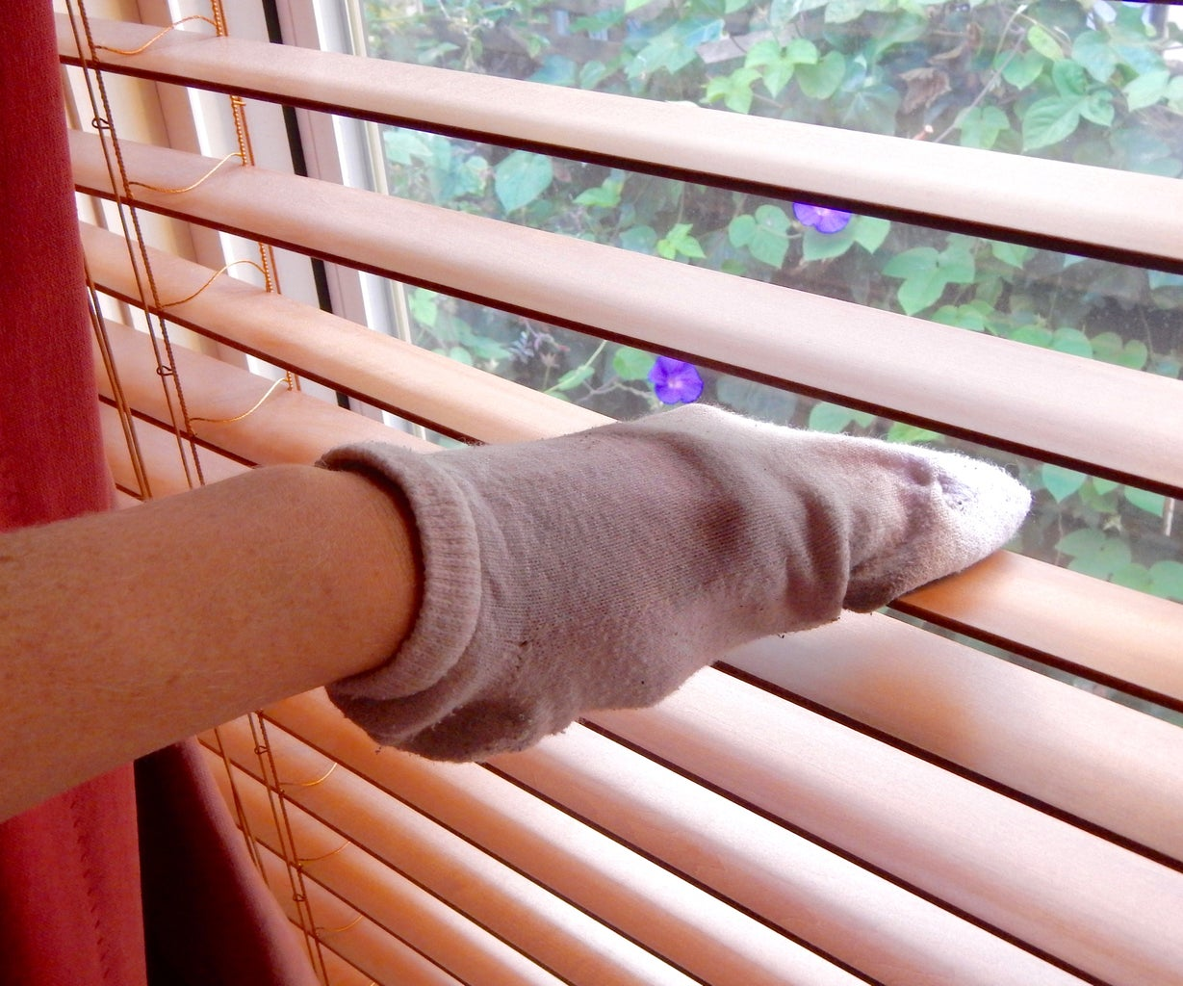
Fun Builds Tolerance!
  Sometimes kids need a little more fun to TRY chores
  Use socks as “dust mitts”
  Hide coins/dollar bills/stickers under furniture when vacuuming, sweeping, or gathering items to set the table
  Use dry erase markers to draw faces on dishes and encourage your child to wash them off
  Play with rice/sand bin, then ask child to sweep it back into the bin!
  Do some water play, then have your child practice wiping spills
  Decorate a cleaning caddy or special apron with them!

Slide 23
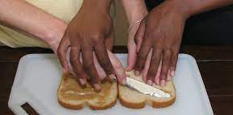
Errorless Teaching
  What it is:
    Helping them perform the task thoroughly (no errors)
    Hand-over-hand
      Ex: wiping a table
      Ex: pouring snack crackers onto a plate
  When to use:
    First time your child is asked to perform chore
    If after 2-3 separate tries, your child is still scoring 1 on the thoroughness scale

Slide 24
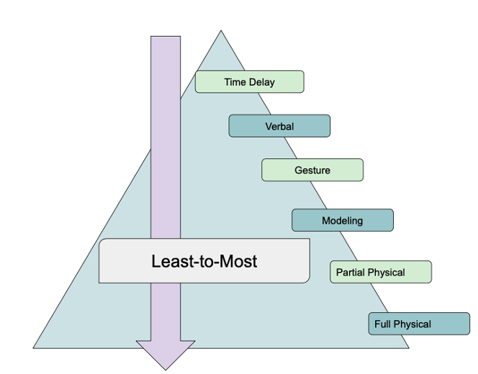
Prompts and Prompt Fading
  Differs with every child, for every skill!
  Use “most-to-least” if your child shows very little or no thoroughness
  Use “least-to-most” if your child’s thoroughness is improving
  Over time, we want to fade these prompts to build independence!
    Ex: Helping your child begin to make a pile while sweeping, then letting go of the broom
  Silent prompts
    Ex: Point prompts

Slide 25

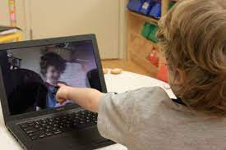
Video Modeling
  A video that provides a visual model of the target skill.
  Research supports that video models may support skill development even more so than in-vivo models!
  4 types:
Basic
Self-modeling

Slide 26
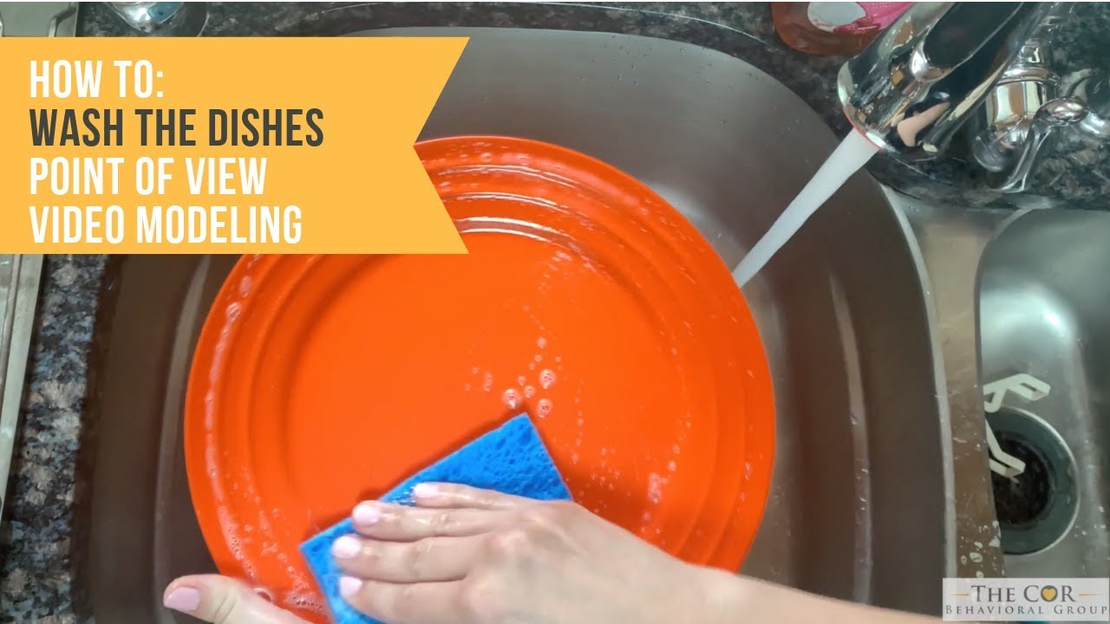
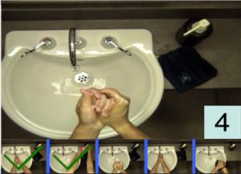
Video Modeling
  A video that provides a visual model of the target skill
  Research supports that video models may support skill development even more so than in-vivo models!
  4 types:
Point of View
Video Prompting

Slide 27
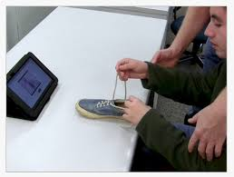
Video Modeling
  When to use:
    If your child attends well to a screen!
    Before practicing a skill
    As error correction
  Making a video:
    Practice first
    Keep it brief!
    Avoid clutter (prevents overselectivity)
    Use siblings!

Slide 28
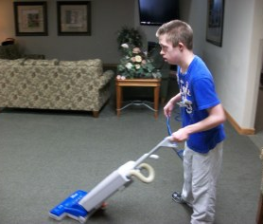
Video Modeling
  When to use:
    If your child attends well to a screen!
    Before practicing skill
    As error correction
  Making a video:
    Practice before filming
    Keep it brief
    Eliminate clutter in background (prevents overselectivity)
    Use siblings! ☺
  Fading:
    Play first few seconds
    Only play for error correction

Slide 29
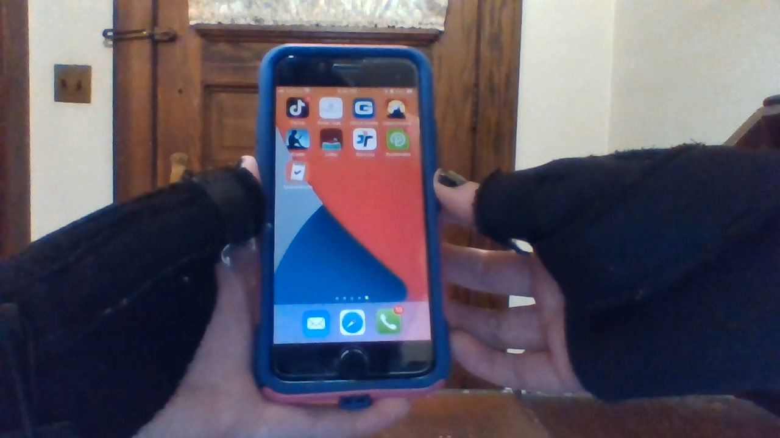
Video Modeling Applications
  Store in video album on iPad/iPhone or Android
  iModel – $9.99
  Task Analysis Life – FREE!

Slide 30
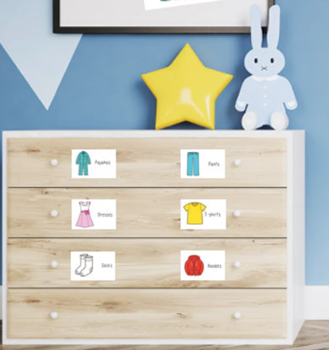
Visual Prompts
Add them to materials
Sweeping
Tape on broom where 2 hands are placed
Tape box on floor to sweep into a pile
Microwave use
Place colored stickers on numbers for correct time (ex: red for pizza)
Add them to storage locations
Cabinets/drawers for groceries, snack items, cleaners, dishes, clothes, etc.

Slide 31
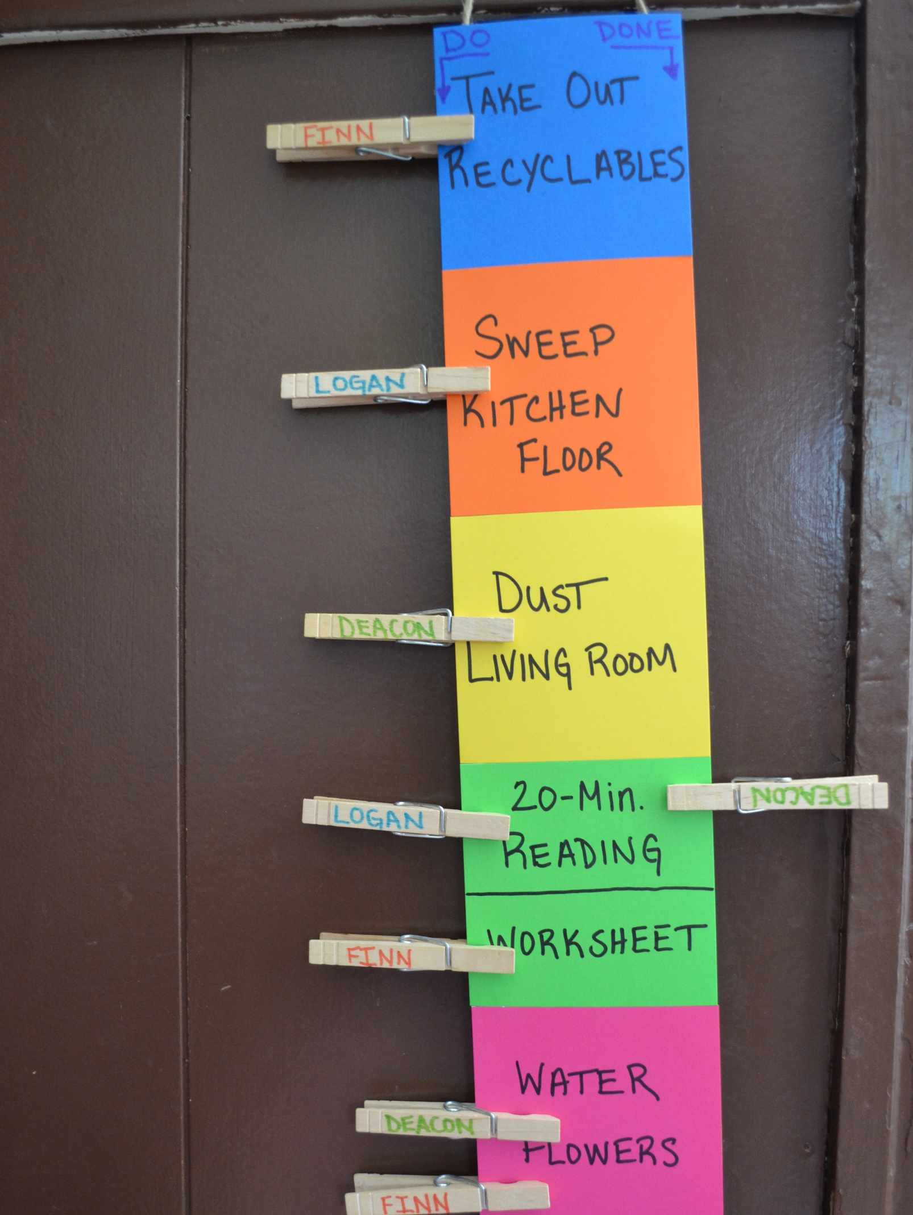
Visual Schedules
  Can help children…
    Sequence steps of a task
    Sequence multiple tasks
    Self-monitor
  Chore Charts…
    Great for building independence!
    Can use removable velcro, dry-erase, clothespins, apps, etc.

Slide 32
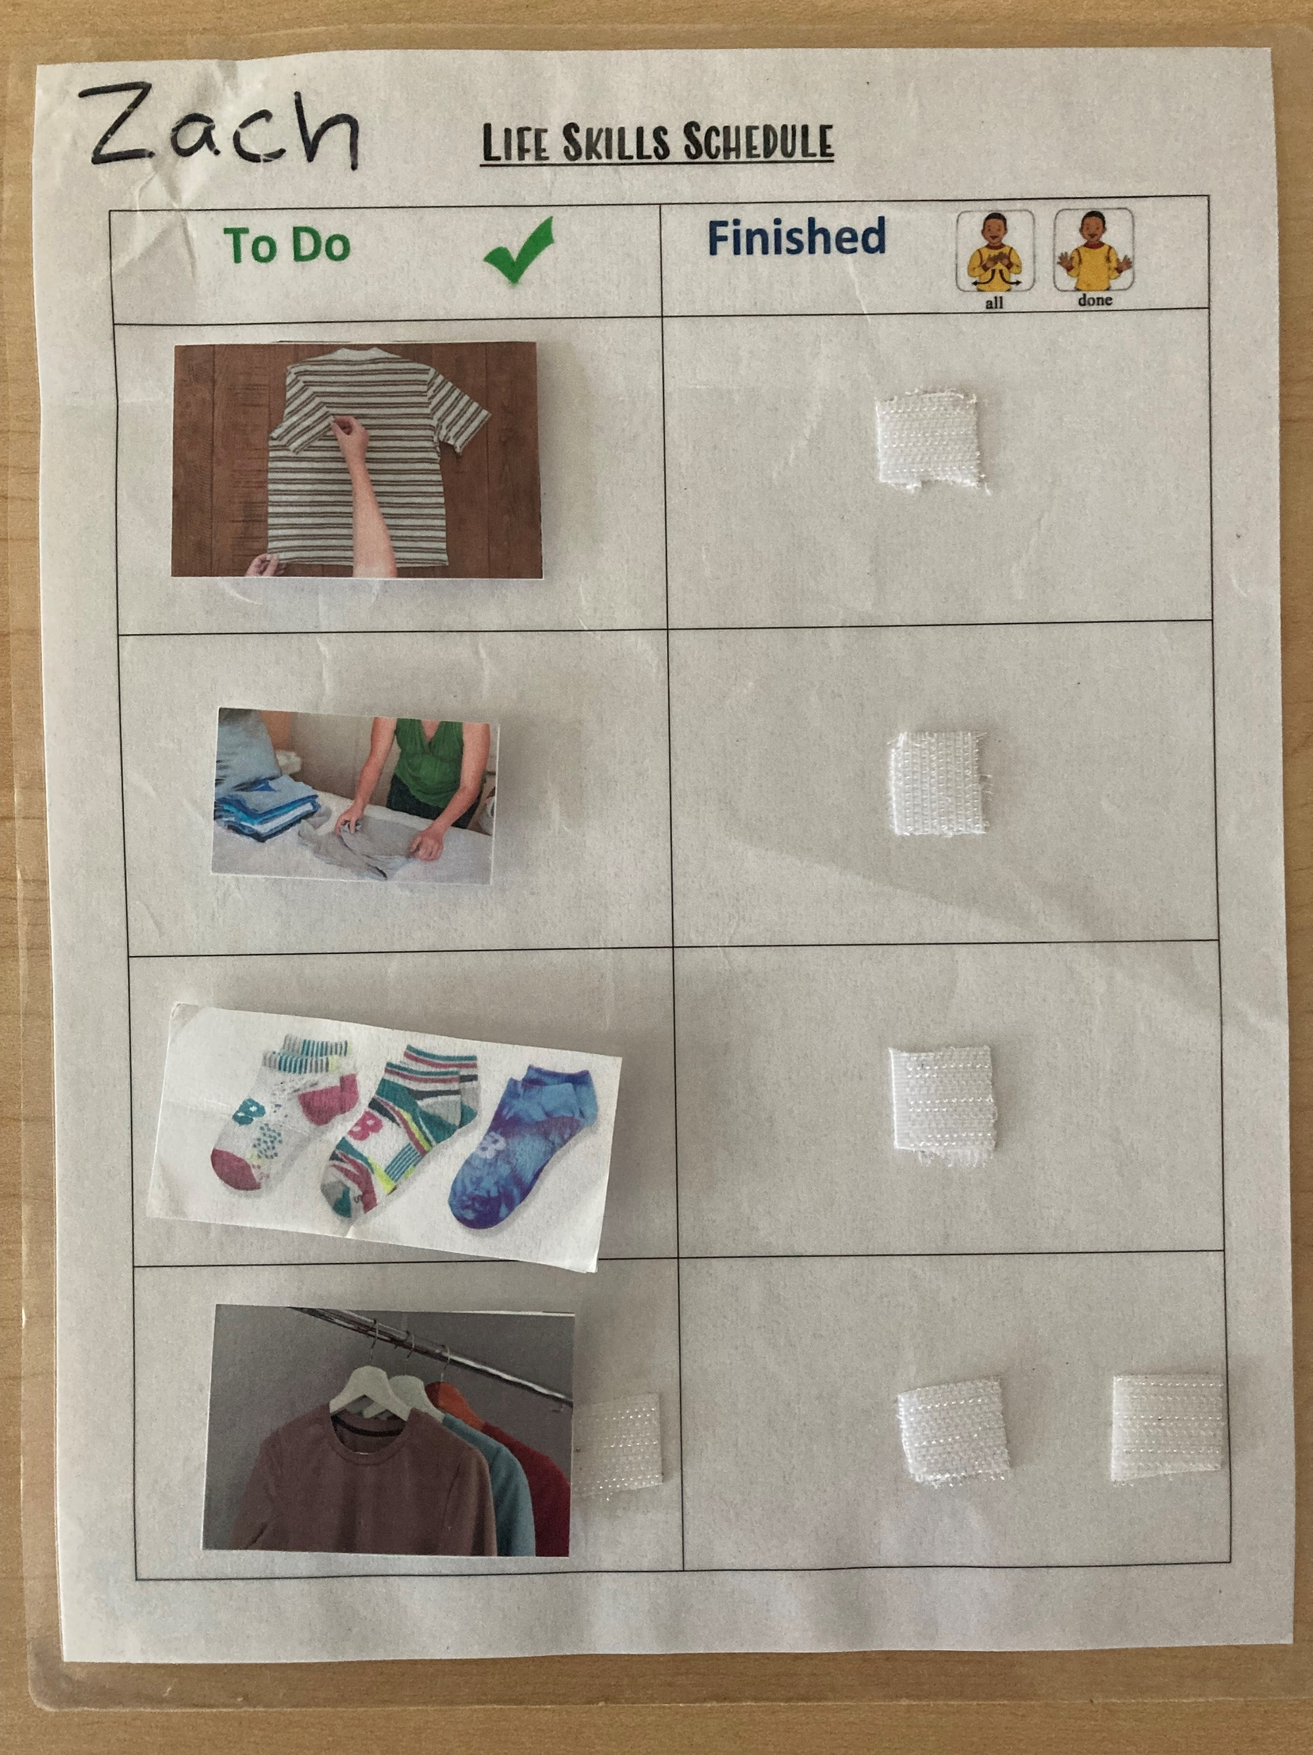

Visual Schedules

Slide 33
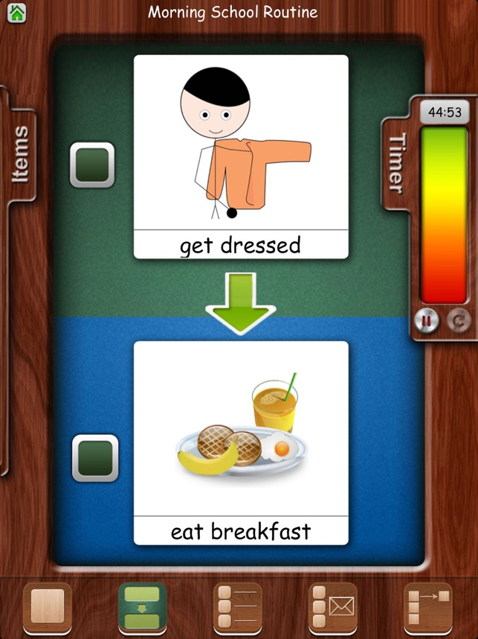
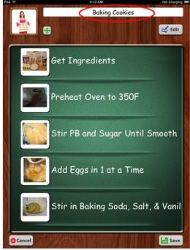
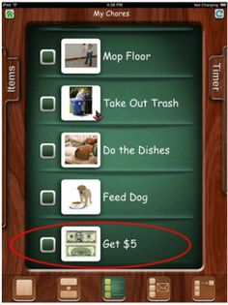
Visual Schedule Applications
    FSTV HD

Slide 34
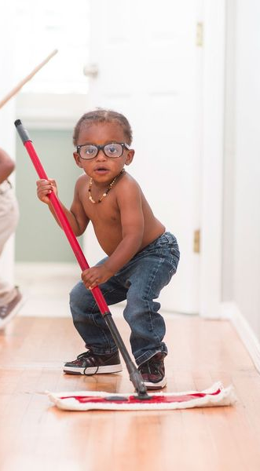
Parting Words…
    Encourage choice
      Order of chore completion
      Materials used
      “Where to start”
    Expose your child to new chores!
    Keep high expectations
    YOU are your child’s FIRST and BEST teacher ☺

Slide 35
Thank You!
    Please see the website for access to the chore checklist
    Reach out to me at jgunner@thesummitcenter.org with any comments/questions!

Slide 36
Sources
    Please refer to resources attached
    Reach out to me at jgunner@thesummitcenter.org with any comments/questions!
    Any questions now?

