Slide 1

Sleep Basics
Presented by Stacey Chambers, MSEd. BCBA

Slide 2
Learning Objectives
Identify how much sleep children should be getting.
01
Discuss common sleep problems.
02
Discover strategies to help families identify sleep patterns.
03
Learn the essential elements of a strong bedtime routine.
04

Slide 3
How much sleep should we be targeting?
Age | Hours of Sleep (in a 24-hour period) | Naps?
4-12 Months | 12 – 16 Hours | Yes
1-2 Years | 11 – 14 Hours | Yes
3-5 Years | 10 – 13 Hours | Yes
6-12 Years | 9 – 12 Hours | No
13-18 Years | 8 – 10 Hours | No
As per the American Academy of Sleep Medicine
Notes:
First things first, let’s look at how much sleep children actually need. This information comes from a Consensus Statement publish by the American Academy of Sleep Medicine.

Slide 4
Common sleep Challenges
Battles during bedtime
Difficulty with sleep onset
Nighttime awakenings / Early waking
Sporadic sleep schedules
Notes:
Now that we know how much sleep your child should be getting, let’s look at what is preventing them from getting the recommended sleep. There are several types of sleep challenges. The ones most commonly impacting young children and that we will focus on today are:

Slide 5



How Much sleep is your child getting?
When are they getting it?
Notes:
Regardless of which type of sleep issue you are dealing with, it is helpful to collect some data to get a better picture of how much sleep they really are getting and when they are getting it. This may feel like a tremendous amount of effort, and it might be the last thing you feel like doing when already sleep deprived, but there is tremendous value in getting a clear picture of what your child’s sleep really looks like.
For some families simply adjusting the time when the child sleeps can have a huge impact on their overall sleep habits.
The next few slides will be examples of data collection tools you can use to help you gain a better understanding of your child’s sleep. You can choose the one that is right for you.

Slide 6
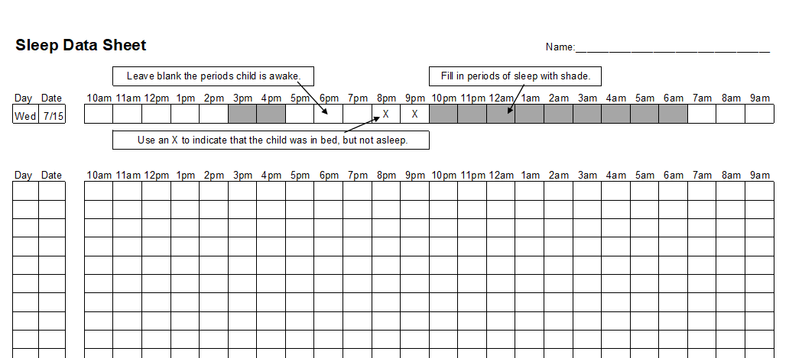

Slide 7
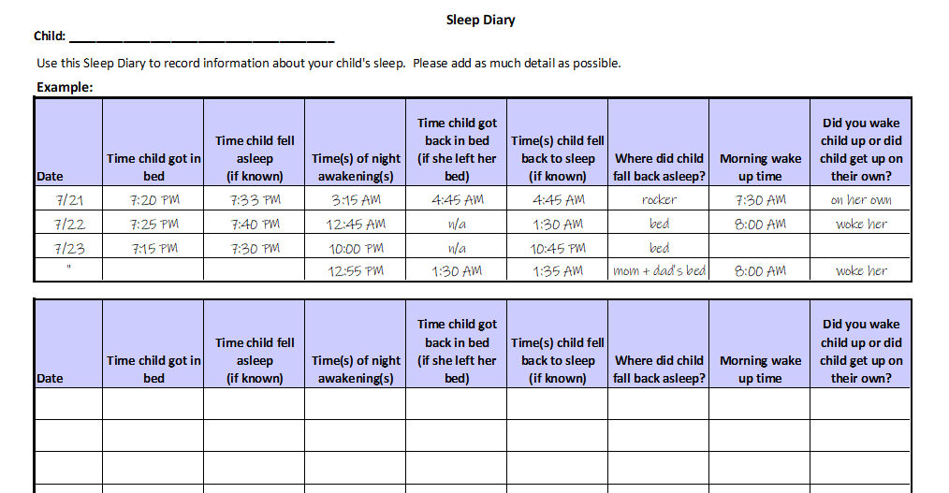

Slide 8
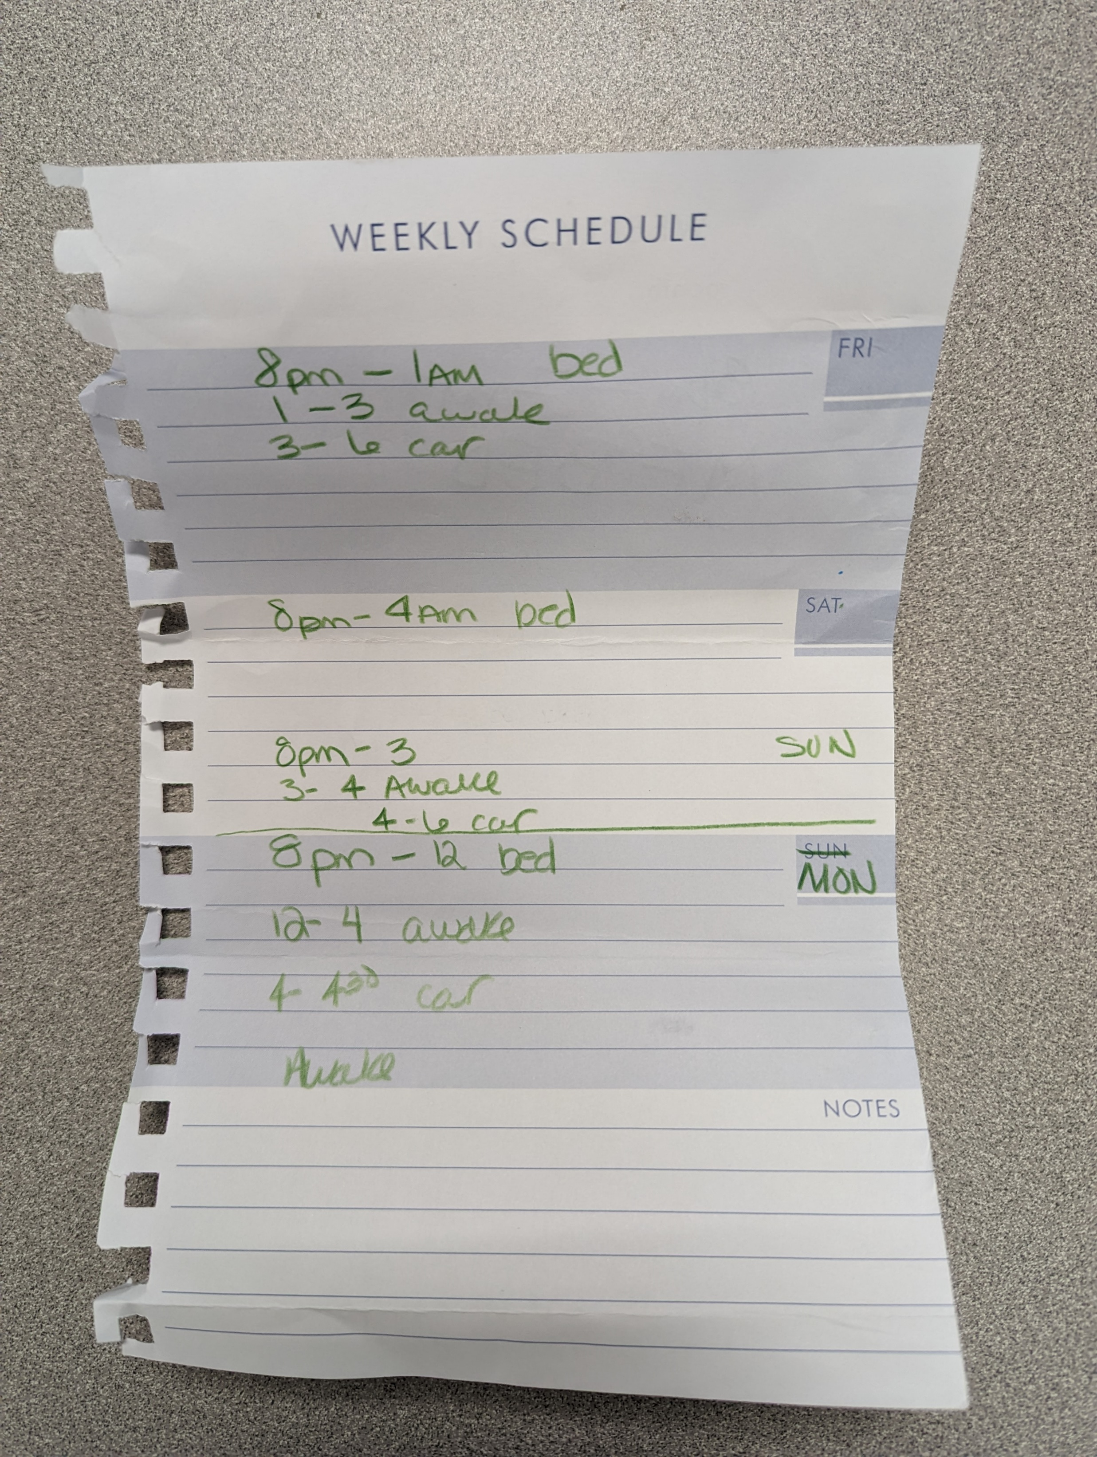

Slide 9
What is the data telling us?
Is the child taking longs naps late in the day and struggling to fall asleep at bedtime?
Does the child sleep consistently through the night, but wakes early than desired?
Does the child have to be woken up in the morning and appears to not be fully rested?
Does the child take longer than 30 minutes to fall asleep at bedtime?
Notes:
Once you have collected data for several days, start to look for patterns in the data.
What is the data telling us?

Slide 10
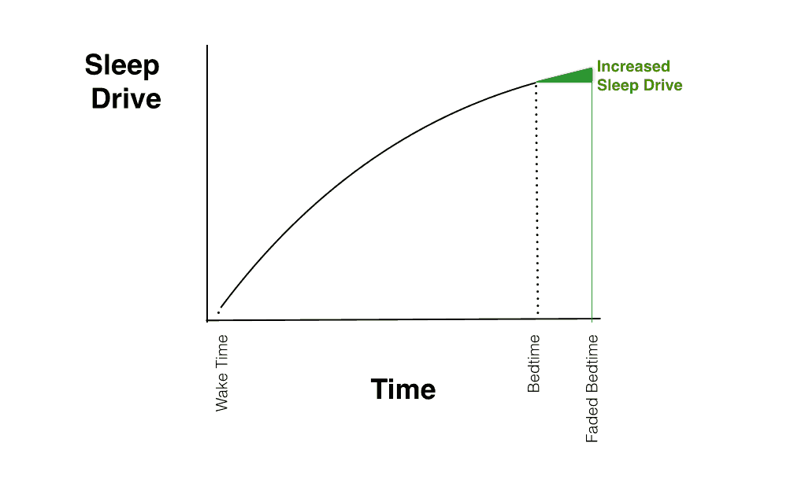
Notes:
Sleep drive is an important consideration. Sometimes bumping bedtime back just a few minutes can make a huge difference.

Slide 11
Stopping point
Are there changes that could be made to the sleep schedule that might alleviate some of the difficulties?
Notes:
This is a stopping point. Use the data you collected and the patterns that you observed to make adjustments to the sleep schedule. For many families these minor adjustments can be enough.

Slide 12

Create a consistent
Runway to Bedtime
Notes:
If adjusting the sleep schedule alone is not effective, one of the next things to do is look at your family’s runway to bedtime. “Bedtime” really starts about 2 hours before actually getting into bed. Creating a consistent runway to bedtime can significantly impact sleep habits.

Slide 13
Key elements of a Good Evening routine
CONSISTENCY
Anchor routine with mealtimes
    Limit intake of liquids and sugary food beginning 2 hours before bedtime.
Avoid high intensity physical activity in the evening
Give shower/bath early in the evening
Notes:
There is no cookie cutter evening routine that guarantees a good nights sleep, but here are some elements of a good evening routine…

Slide 14
Stopping point
Are there changes that could be made to your child’s runway to bedtime?
Notes:
This is another stopping point. In thinking of your family’s nighttime routine are there things you could tweak to give your child a smoother runway to bedtime?

Slide 15
Falling Asleep
Sleep Latency = The time it takes to fall asleep once your head hits the pillow.
It should only take 2-3 minutes to fall asleep.
“The ability to fall asleep quickly is a skill.”
Notes:
A healthy sleeper should fall asleep within 2-3 minutes of their head hitting the pillow. For many young children this is not the case because the ability to fall asleep quickly is a skill. For many young children it is a skill that has to be taught.

Slide 16
Does your child have sleep dependencies?
Sleep Dependencies
Parents
Screens
Bottles / Full Stomach
Pacifiers
Substances
Lights
Music
…
Notes:
Many young children struggle to fall asleep because their ability to do so is tied to sleep dependencies. These are elements of bedtime that must be in place for the child to fall asleep.
An additional challenge related to sleep dependencies is that when a child awakens during the night, a natural human experience. We all do this about 8 times a night, all of these dependencies will need to be in place for the child to fall back to sleep.

Slide 17
Stopping point
Are there sleep dependencies you could fade?
Notes:
So….this is our last stopping point for today. Are there sleep dependencies in place that you could begin fading?
Begin to decrease the quantity of bedtime bottles.
Remove pacifiers across the day.
Turn off screens as a part of the bedtime routine and replace them with interactive activities.
If you rock the child to sleep, place them in the crib just before they fall fully asleep.
These are just some suggestions. Begin slow, just begin somewhere.

Slide 18
Additional resources
It’s Never Too Late to Sleep Train by Dr. Craig Canapari
Sleep Better by V. Mark Durand
Greg Hanley’s Presentation “Understanding and Treating Sleep Problems of Children with Autism”
https://www.youtube.com/watch?v=_H1I-QEENmg&t=354s&pp=ygURZ3JlZyBoYW5sZXkgc2xlZXA%3D
Notes:
If you are interested in additional resources on sleep, these are a few of my favorites…

Slide 19

Questions

Slide 20
Thank you!
Stacey Chambers
(716) 629-3462
schambers@thesummitcenter.org
Notes:
I apologize again for the technical difficulties and not being able to be with you for this presentation. If you have ANY questions, please do not hesitate to reach out to me. I am always happy to help!

